Slide 1
PIZZA MANAGEMENT SYSTEM

Slide 2
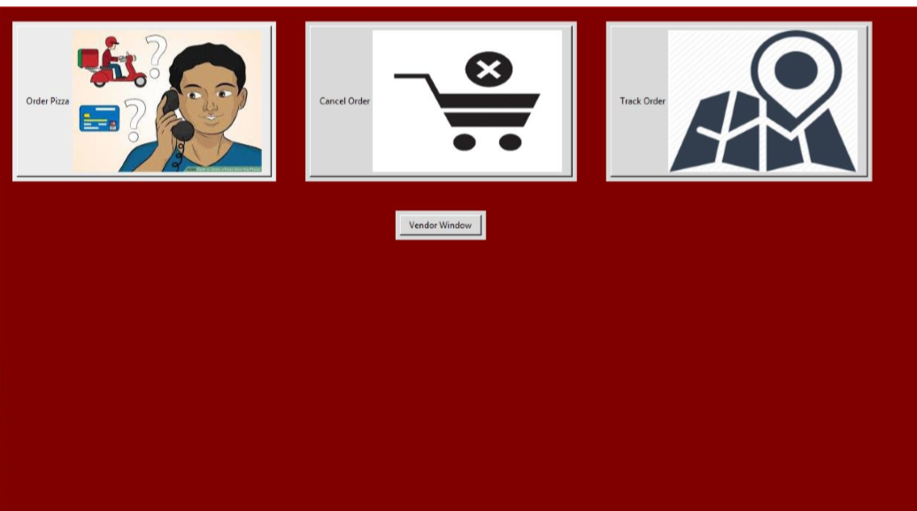
HOME PAGE

Slide 3
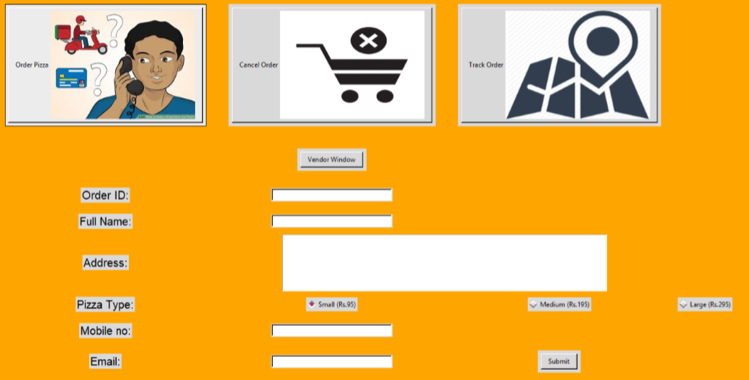
ORDER PIZZA

Slide 4
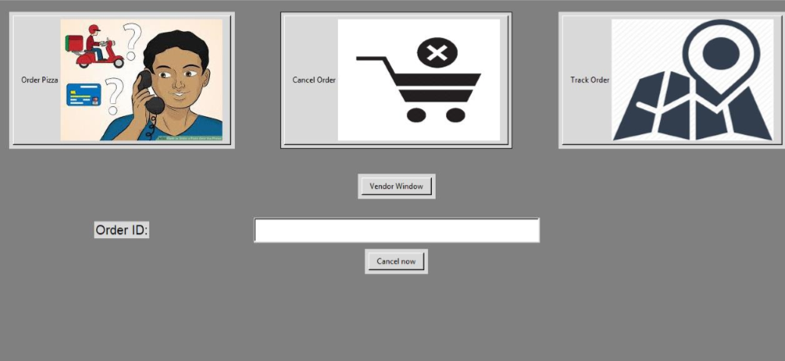
CANCEL PIZZA

Slide 5
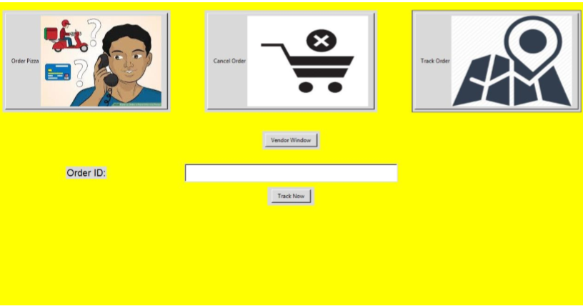
TRACK NOW

Slide 6
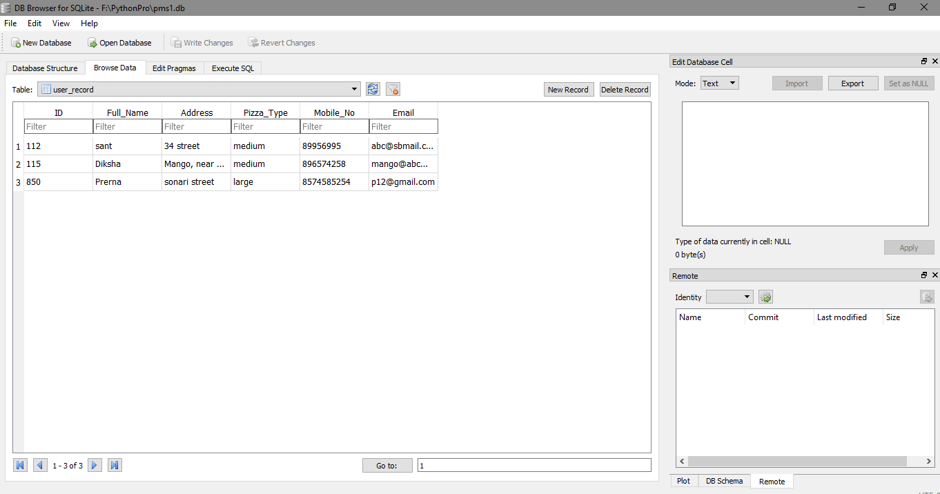
Order details in database

Slide 7
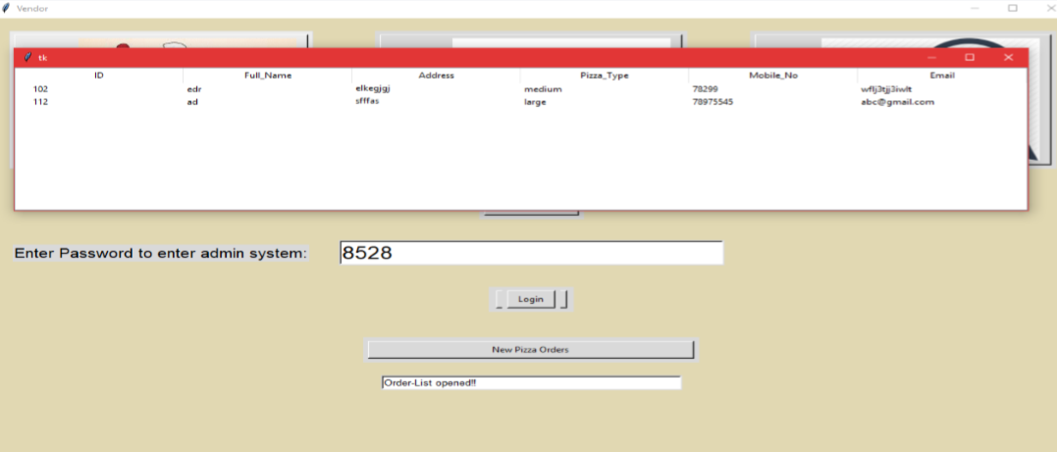
TREE VIEW

